Slide 1
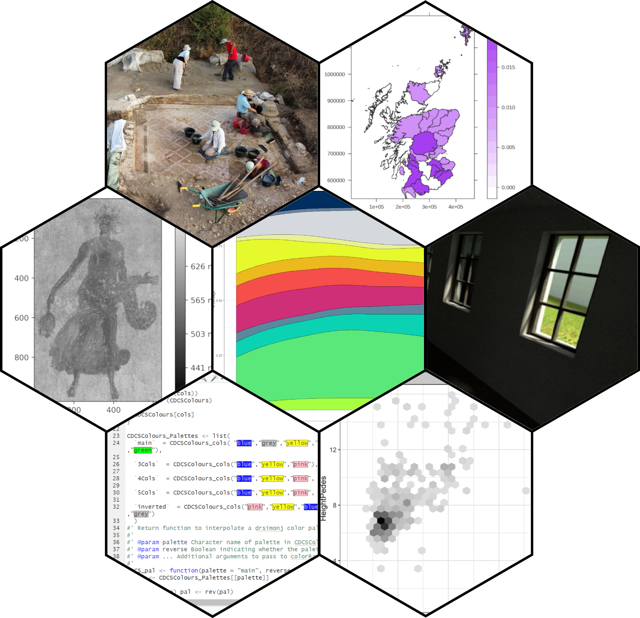
Design Informatics Presentation
Dr Lucia Michielin

Slide 2
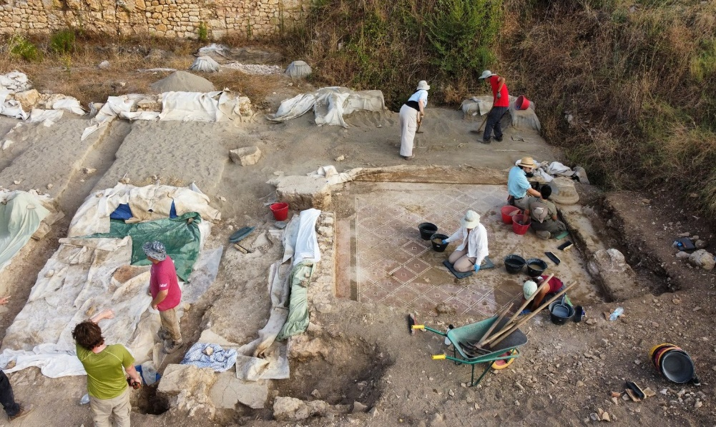
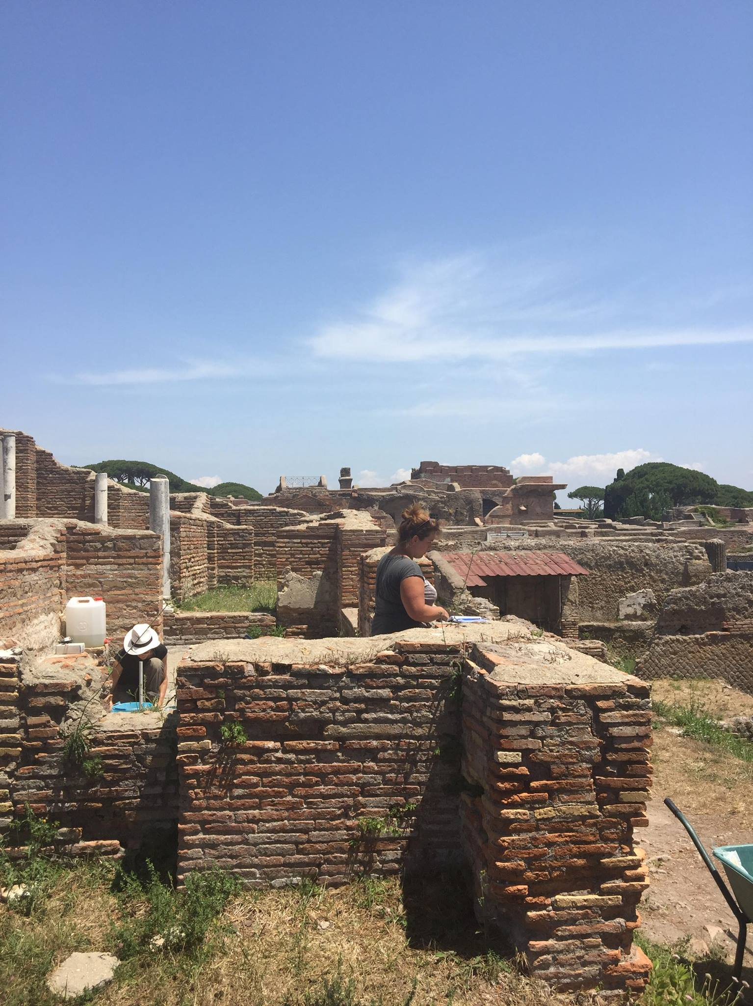
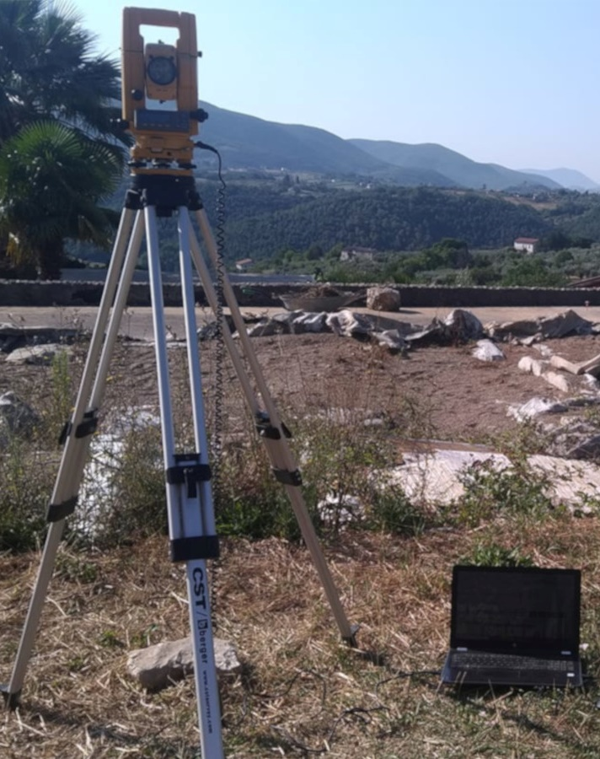
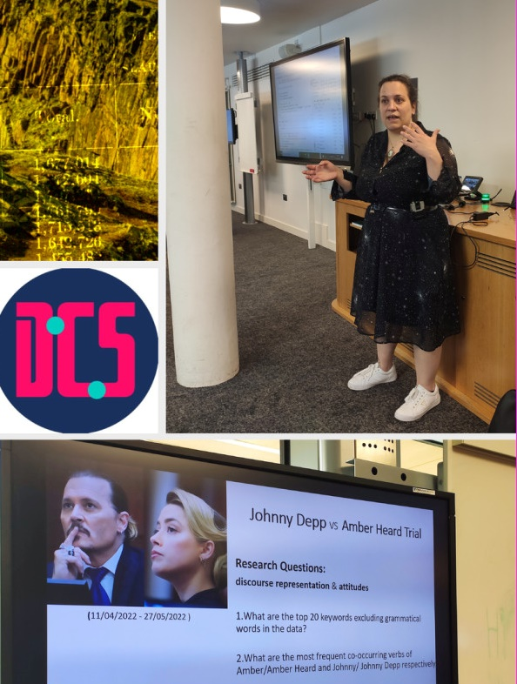
My Background
Masters in Geo-technologies for Archaeology
PhD in Classical Archaeology (Computational Archaeology)
Digital Skills Training Manager for CDCS

Slide 3
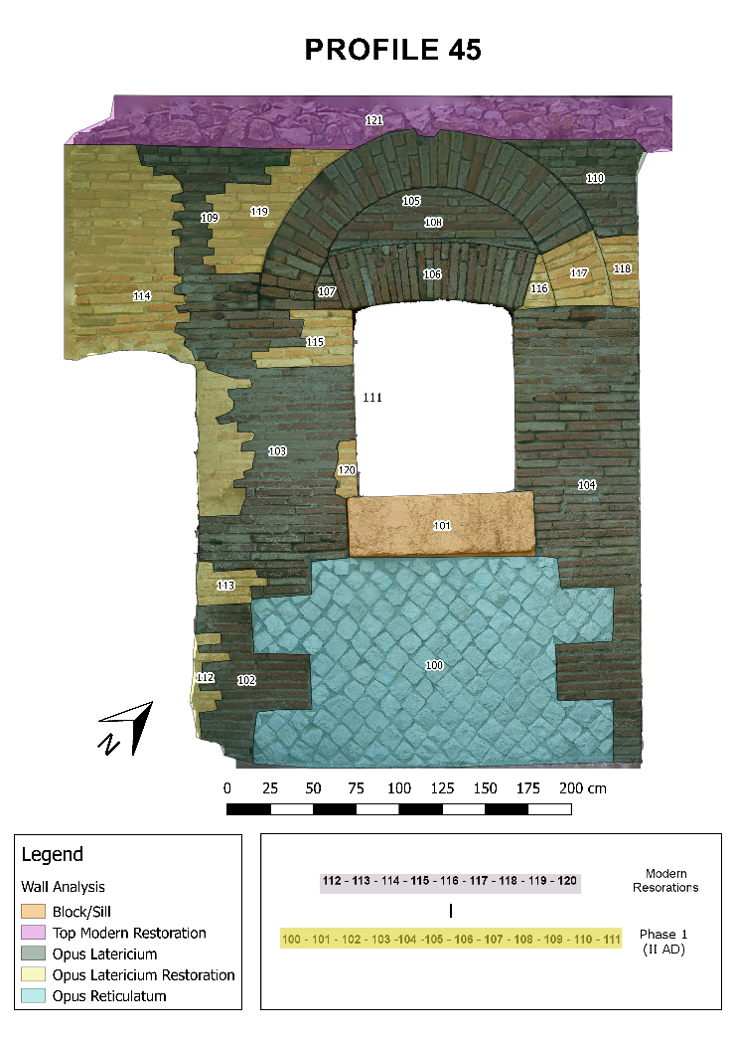
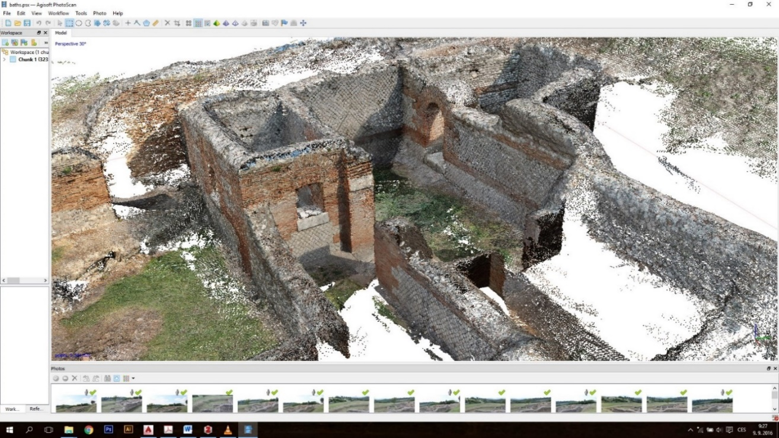

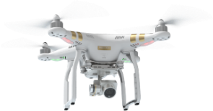


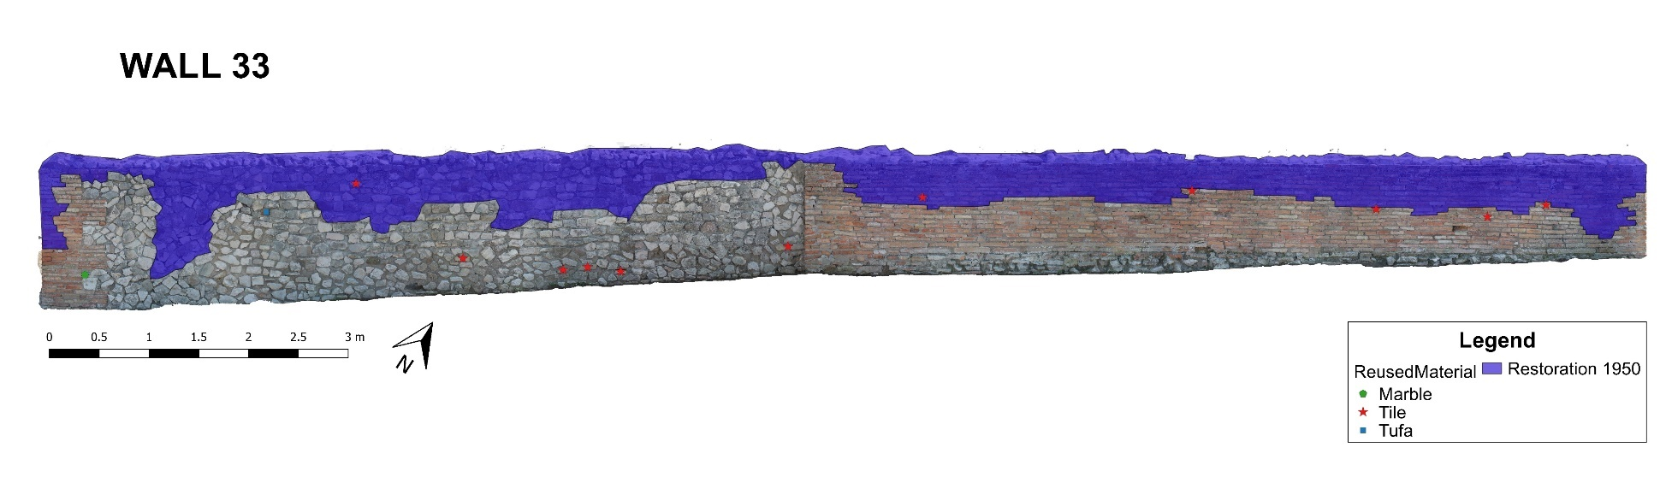
Photogrammetry and GIS for Archaeology

Slide 4

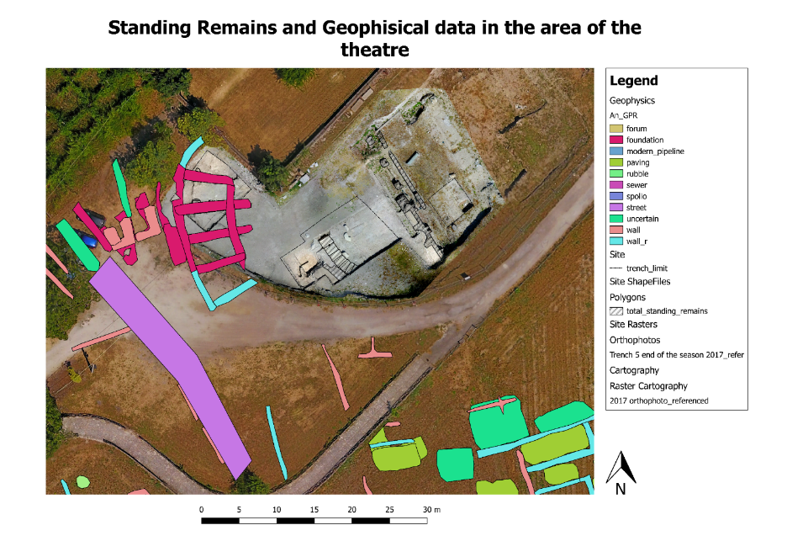
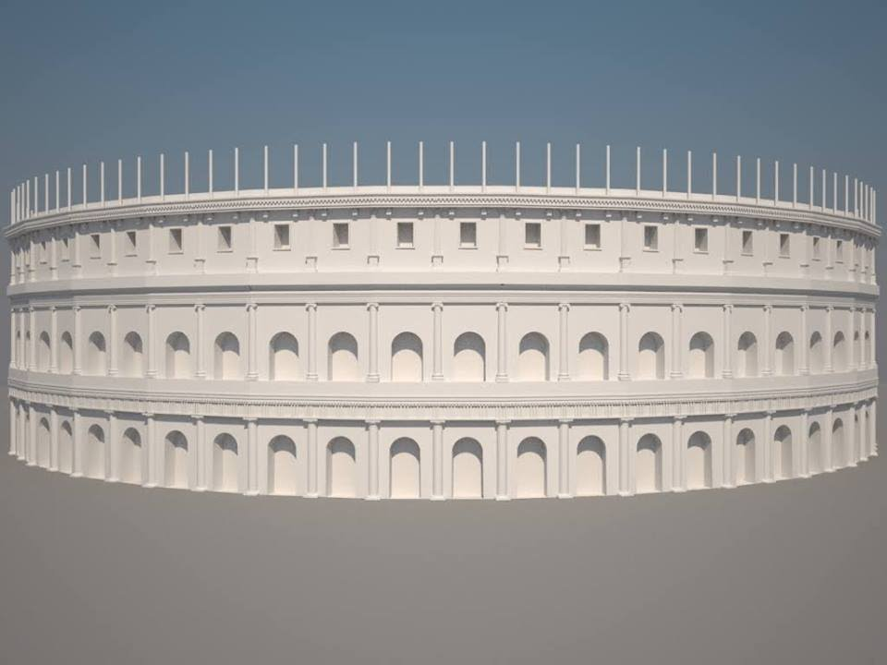
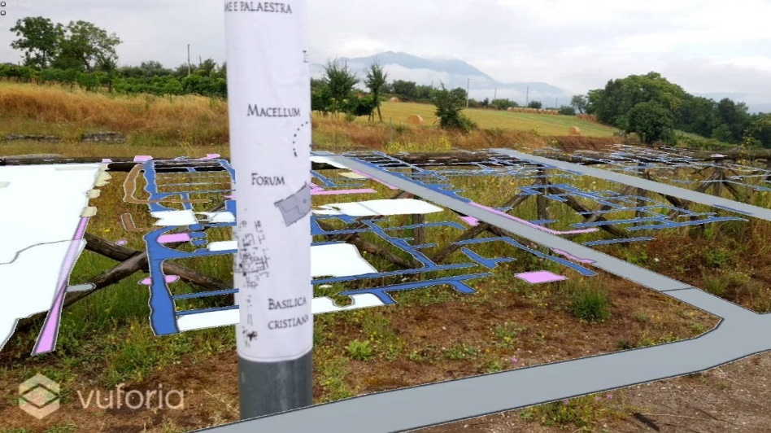
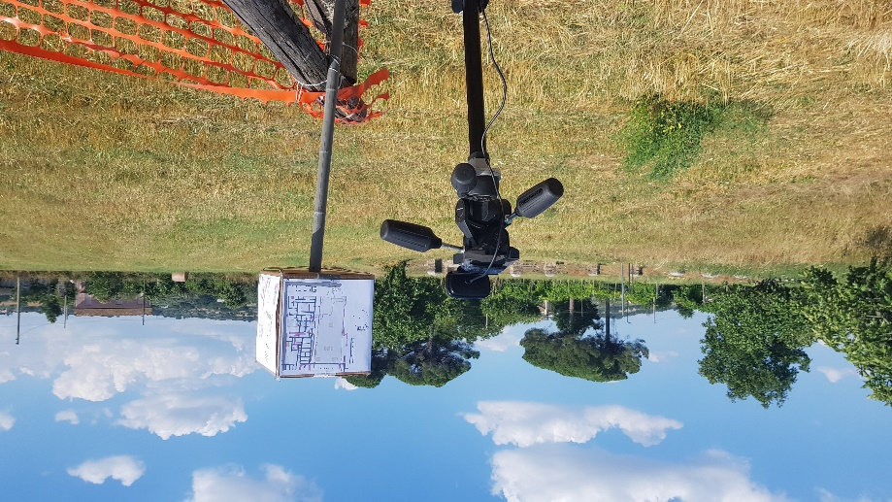
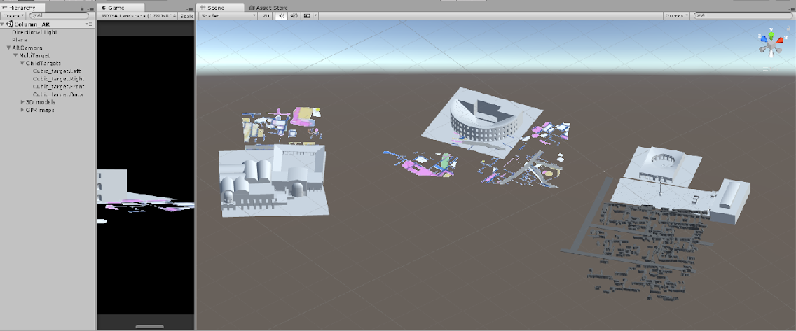


GIS and 3D Reconstructions for Heritage

Slide 5
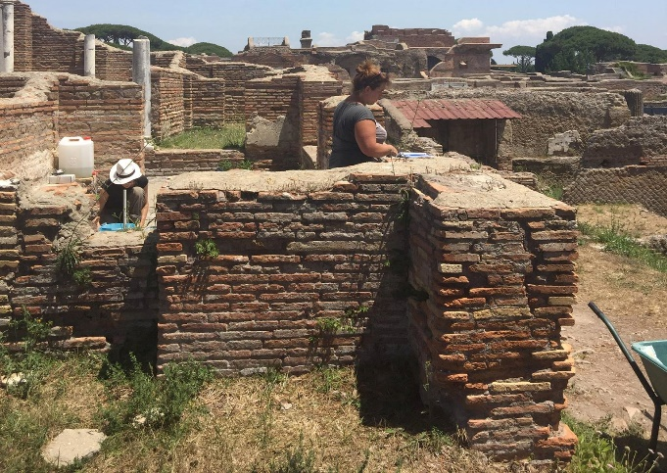
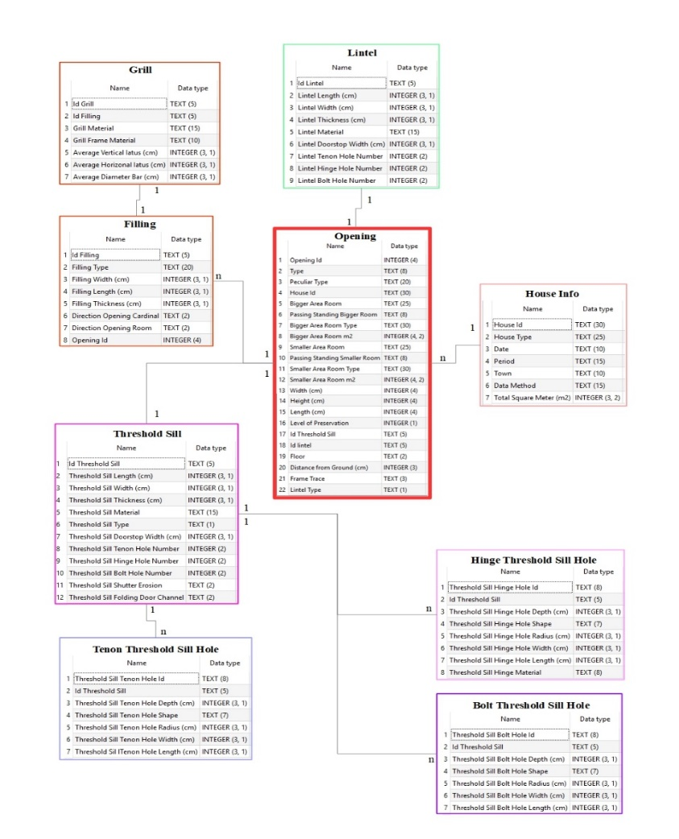
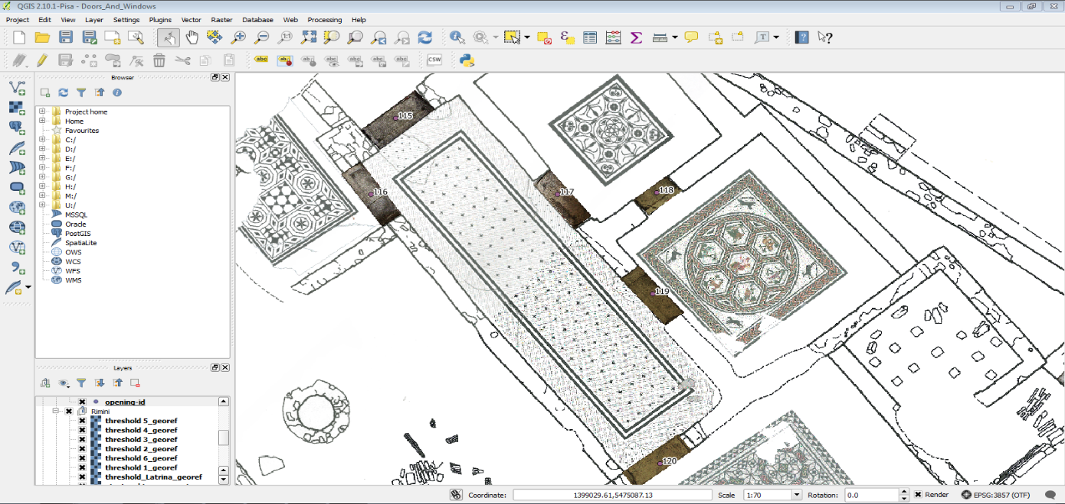
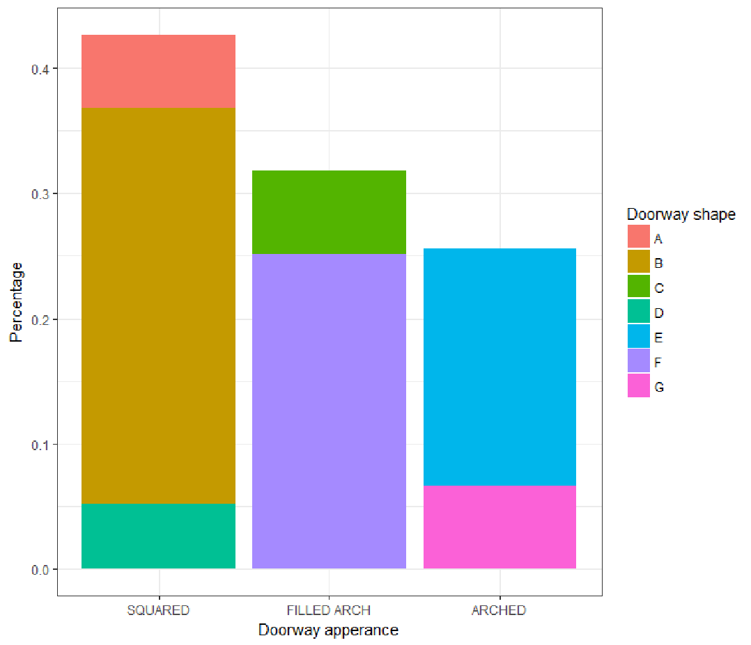
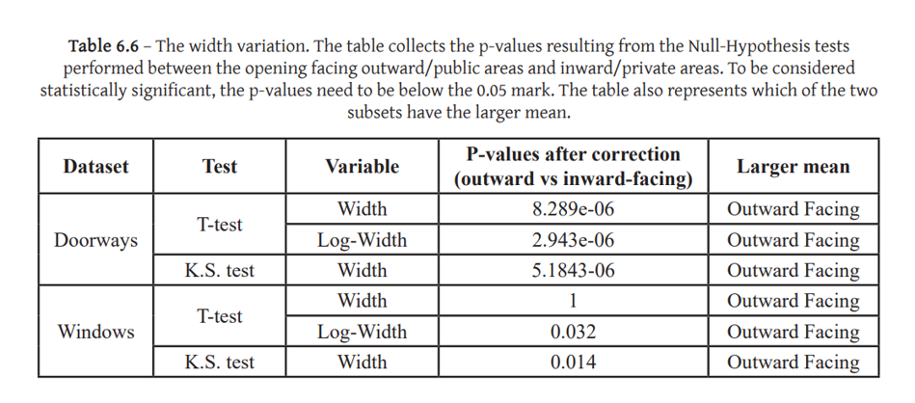



From Statistics to Light Simulation

Slide 6


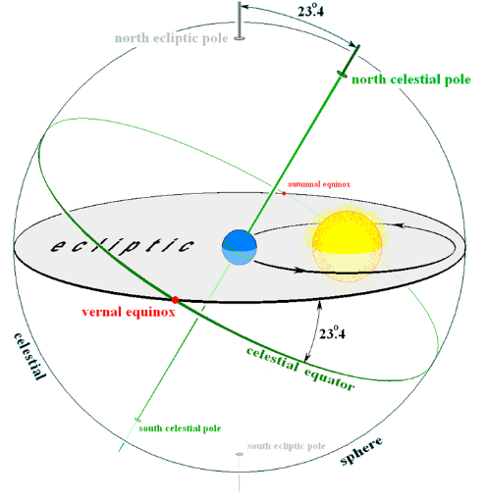
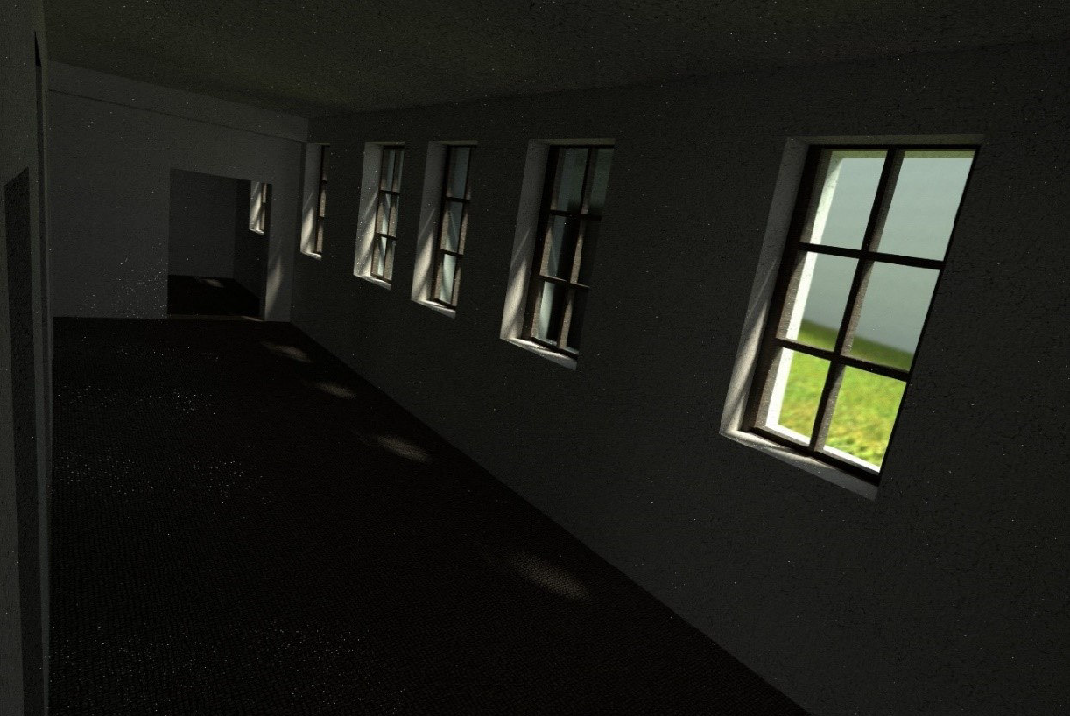
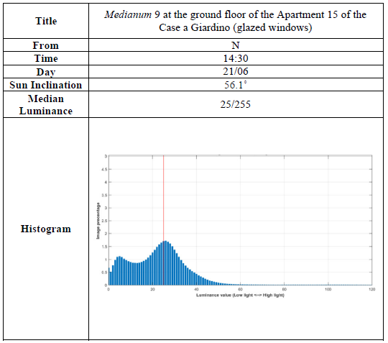
From Statistics to Light Simulation

Slide 7
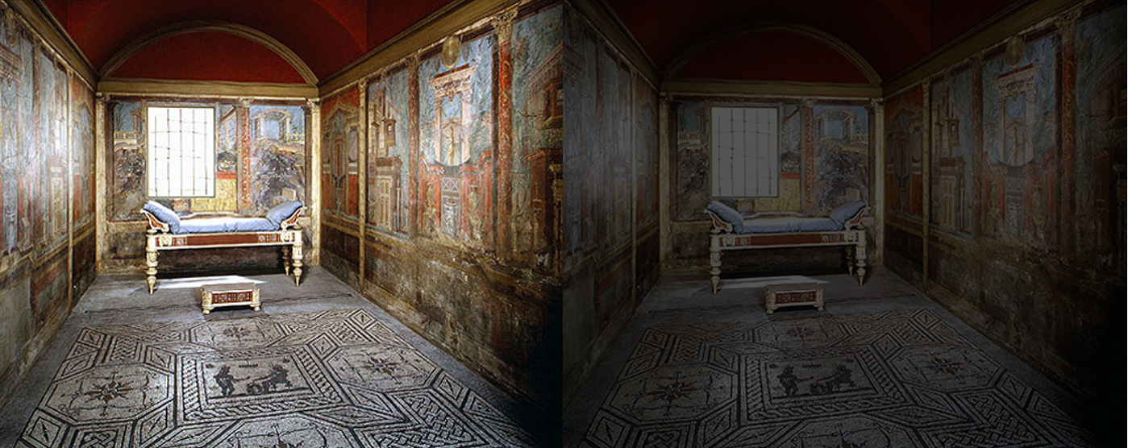
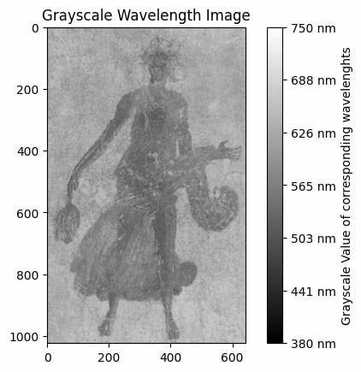
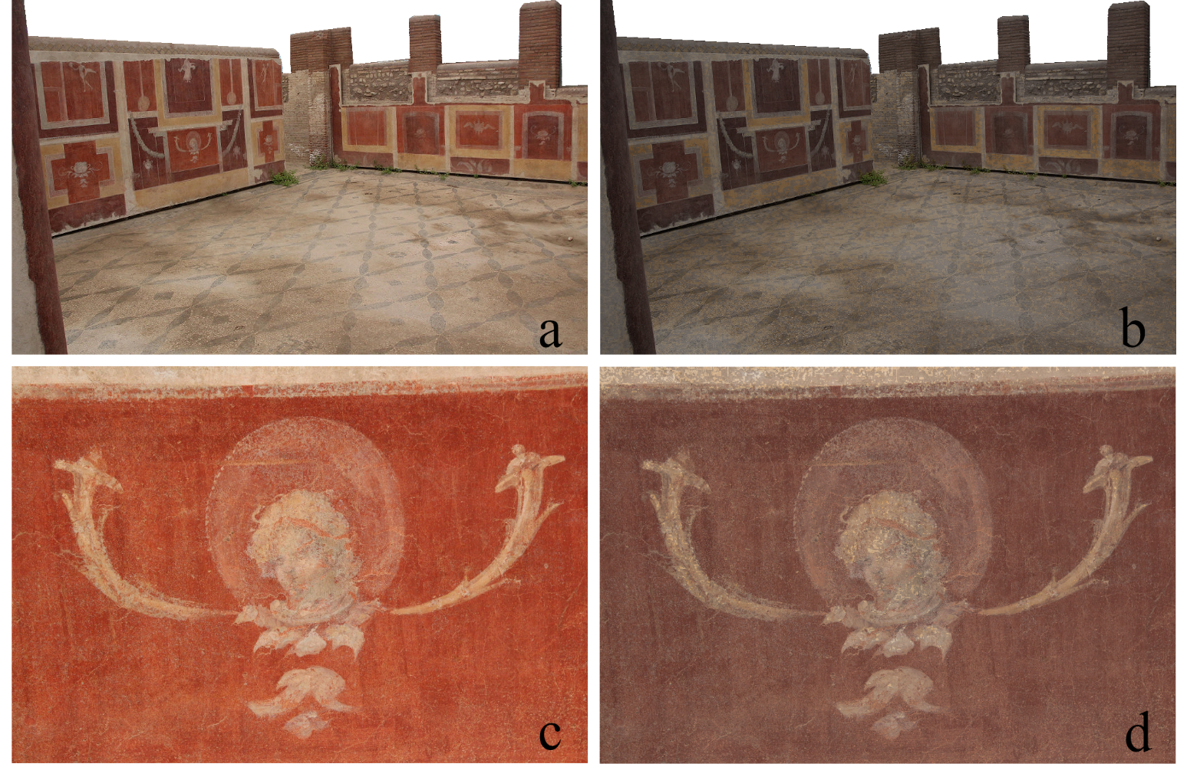



Studying the Impact of Light in Roman Frescos

Slide 8
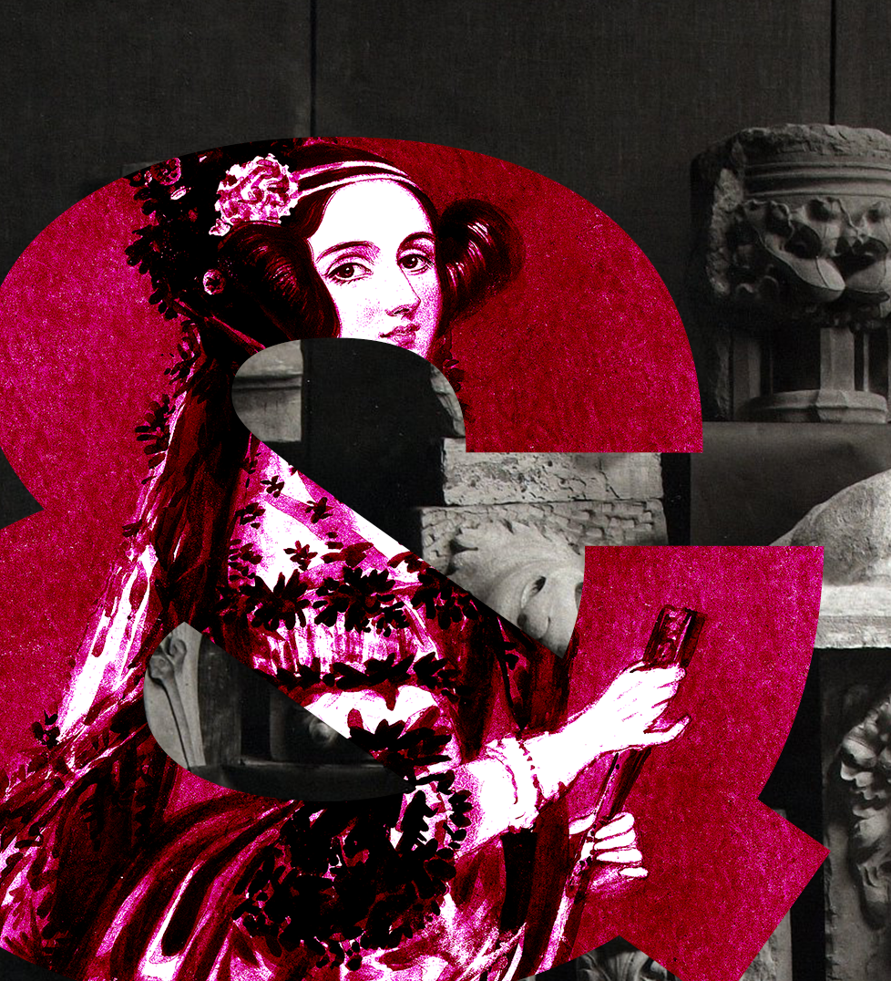
CDCS Training Programme
Applied digital skills training for CAHSS Researchers
Highly interdisciplinary
Research-oriented
One measure does not fit all approach
Reusable and accessible material
Self-learning and asynchronous training/support (GitHub + Pathway of Learning)
Between 700-1000 signups/year from all CAHSS
From ‘Intro to coding’ to ‘Working with 3D data’

Slide 9

The CDCS Summer School
(10-14/06/24)
Focused on hands-on computational methods for data and text analysis.
Different formats each year but each version has focused on helping researchers from higher education institutions develop their digital and computational skills.
2 streams:
A Gentle Introduction to Coding for Data Analysis
Text and Data Analysis in the Wild (2024 theme: The History of Scotland)

Slide 10
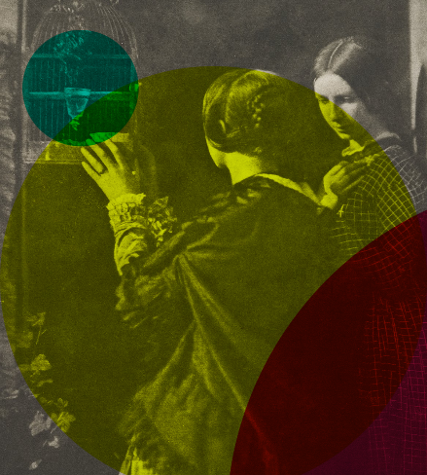
Teaching Philosophy
Breaking the “Language” Barrier
Challenging the STEM vs Arts axiom
Plurality of backgrounds as a resource rather than a hindrance
Computational methods as common language for interdisciplinary work
Coding is creativity by definition

Slide 11
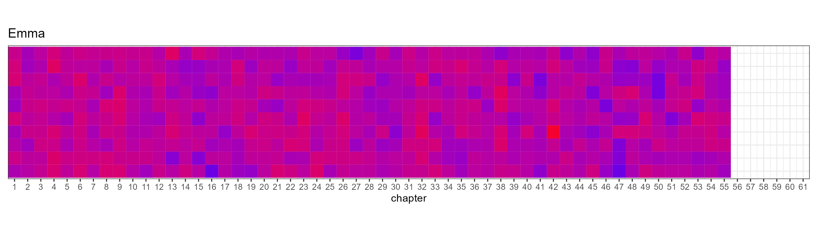
Creative Coding for Design: Using Data to Create
How can different data sources (text, tabular, images, geographical and shapes) be collected, manipulated and transformed to generate new and innovative insight and shape the world around us

Slide 12
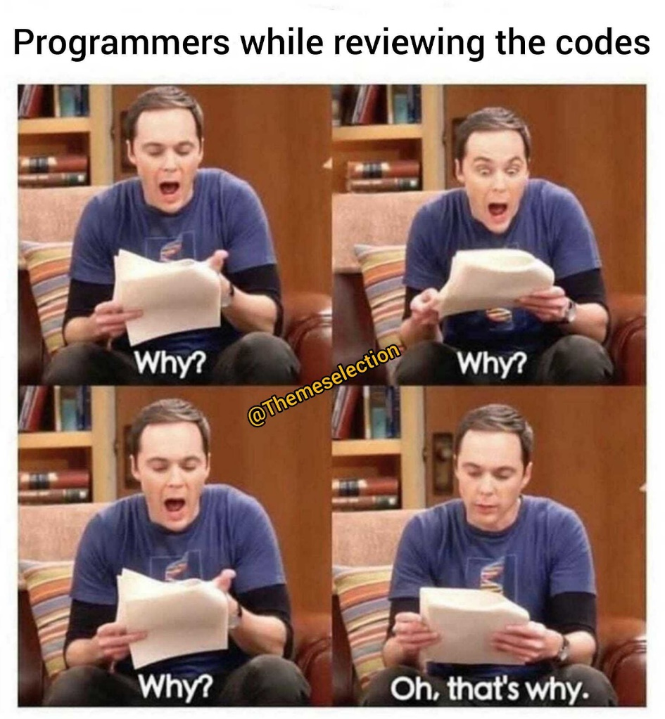
Creative Coding for Design: Learning Outcomes
By the end of the course students would become familiar with
The basics of working with code through R and RStudio
Transform an idea/project into a coding pipeline
Search and adapt code to fit a specific purpose
How different types of data can be collected manipulated and transformed through coding
Good practices of sharing and evaluate other people code
Good practices of working collaboratively in an interdisciplinary context

Slide 13
What you are going to learn
What you are NOT going to learn
Find solutions to tasks and problems through coding
Think outside the box to bring together design and coding
How to efficiently source code to manipulate and transform
How to use coding to create new insight of data and create knowledge
Principles and approaches of working with code
All R and R studio – no one needs to learn the yellow pages by heart to use it
Learn by heart code structure and functions (if you use the same function all over again it may happen but this is not the point of this course)
How to create an app or a website (although you will easily pick up these skills)

Slide 14
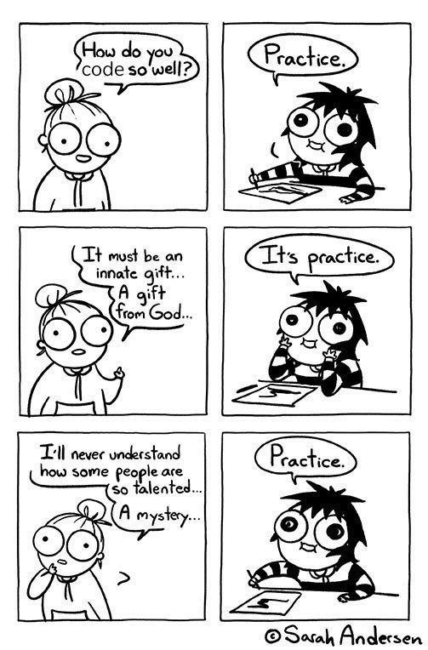
Creative Coding for Design: Structure and Assessments
Lectures + Labs
1h/week Lecture introducing a method and exploring examples
2h/week Lab applying the method to real world dataset with R and R studio (themed)
Assessment: 100% Course work
Small individual project (30%)
Peer review assessment of other groups projects drafts (20%)
Larger group project published in GitHub (40%)

Slide 15
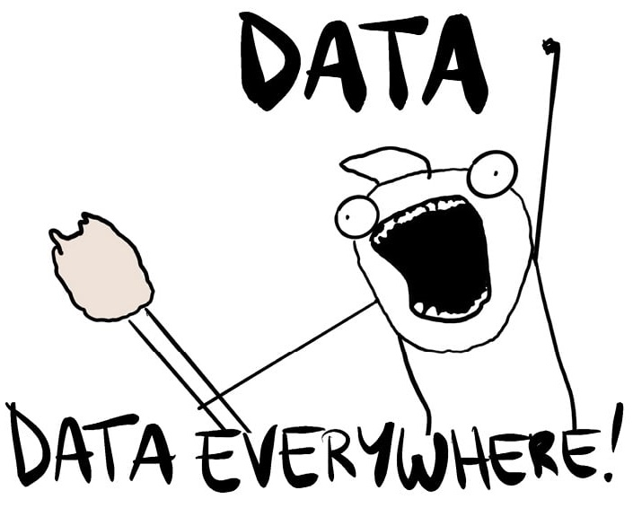
Creative Coding for Design: Structure
Lecture Hours: 11
Lab Hours: 22
Programme Level Learning and Teaching Hours: 4
Directed Learning and Independent Learning Hours: 163
Week 1: What is coding and what are data?
Week 2-3: Mould and transform your data
Week 4: Fetching Data Web scraping and OCR
Week 5-6: Working with textual data
Week 7-8:Working with shapes and images
Week 9-10: Data Visualisation
Week 11: Working Collaborative with Git and GitHub

Slide 16
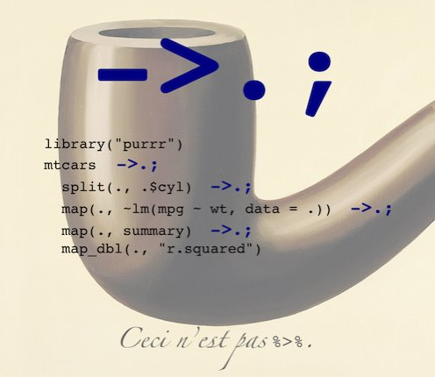
Why coding?
Versatility
Reproducible and easy to share
New approaches to task and solutions-oriented approaches (debugging approach)
Think outside the box
Helps you develop a better understanding of the whole design process
Better at collaborate and working interdisciplinary
Adaptive and useful tool

Slide 17
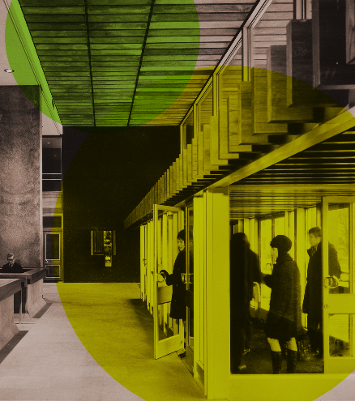
Challenges
Perceived as something separate from design
Lack of a shared language / language barriers
Many disciplines with no tradition in teaching digital skills
Cognitive load
Some techniques would have a fairly step learning curve

Slide 18
But
Lot of similarities with mental processes you are familiar with (coding <-> design process: generate-test-iterate)
Can free you form repetitive tasks
Make your work accessible and reproducible
See data from a different perspective
Add a new tool to your toolbox

Slide 19
What about an example?
Remember the GIF we saw earlier
What do you think the steps to do the same thing manually would be?
… let’s try to see how you can do that with code

Slide 20


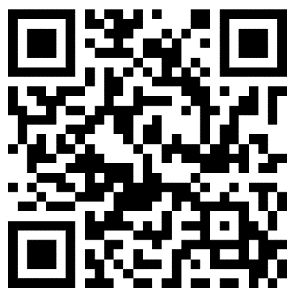
Questions?
You can play around with the code of the demo and access these slides at
GitHub - Lucia-Michielin/DesignInformatics

